Slide 1
Lecture 10
The File System

Slide 2
The Filesystem
The bits stored on a storage media has to be given meaning
Different physical media have different methods of access
I/O drivers finally have to be invoked to perform the actual read of the bits but have to figure out which bits to read and what they mean

Slide 3
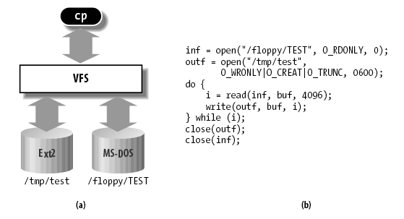
The Virtual Filesystem (VFS)
VFS exposes a uniform API regardless of the underlying implementation or physical realities
Abstracts away the complexities from the users

Slide 4
The Common File Model
Capable of representing all supported filesystems
Any physical representation must be translated into the common file model

Slide 5
The Objects in the Common File Model
The superblock object: stores information about a mounted filesystem
A filesystem is mounted if it is properly set up for use and access
The inode object: stores the general information about a specific file
The file object: stores information about the interaction between an opened file and a process
Exists only in kernel memory during the period when a process has the file opened
The dentry object: stores information about the linking of a directory entry with the corresponding file

Slide 6
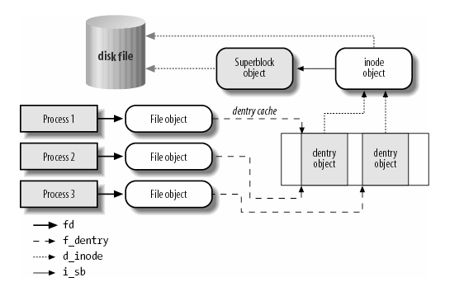
Relationship between the objects
Source: Daniel P. Bovet, Understanding the Linux Kernel.

Slide 7
The Superblock
All superblock objects are linked in a circular doubly linked list
Each filesystem has its own information (s_fs_info)
For disks, this may include allocation bitmaps for allocating and freeing disk blocks
Corresponds to the filesystem control block stored on disk

Slide 8
The Inode
Contains all information needed by the filesystem to handle a file
For disk-based filesystems, it corresponds to the file control block
Each inode is associated with an inode number that uniquely identifies the file within the filesystem
Accessed using “ls -i”
Maximum inode number is allocated during filesystem creation
Inode numbers given in sequence during file creation
Generally accessed using hashing

Slide 9
The File Object
Describes how a process is interacting with an opened file
Created when a file is opened
Main information: the file pointer – the current position in the file to which the next operation will take place
Allocated via a slab cache named filp
Each superblock has a list of file objects

Slide 10
The Dentry Objects
For each directory, there is a dentry structure
Dentry objects also do not have a corresponding structure on disk
Different file systems do directories differently, hence need to “normalize”
Dentry objects are stored in a slab allocator cache called dentry_cache

Slide 11
The Dentry Cache
Constructing a dentry object from disk information takes a lot of time, plus there is usually temporal locality in file usage, hence makes sense to cache
The dentry cache consists of
A set of dentry objects in the in-use, unused, or negative state.
A hash table to derive the dentry object associated with a given filename and a given directory quickly.
The dentry cache also controls the inode cache
Inodes in kernel memory that are associated with unused dentries are not discarded; they can be quickly be referenced again

Slide 12
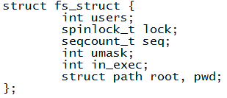
Files associated with a process
Each process descriptor has pointer to its a fs_struct
May be shared by several processes
Another field, the files field of a process descriptor tells which files are opened currently by the process

Slide 13
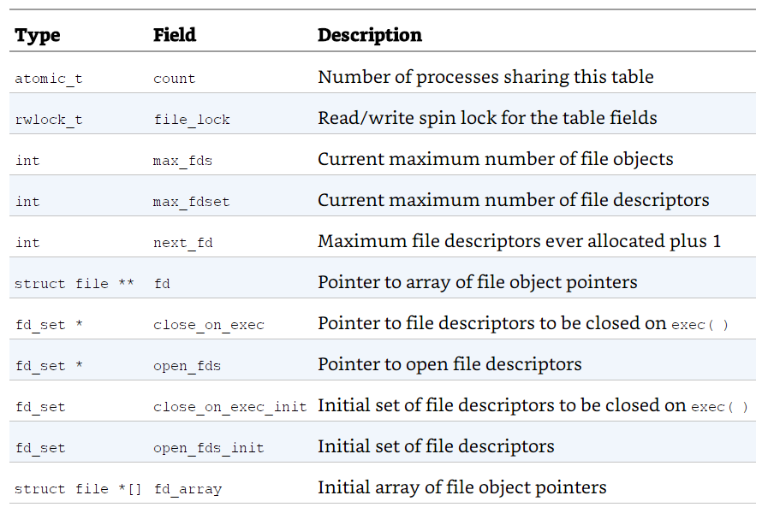
files_struct
Pointed to by the files field

Slide 14
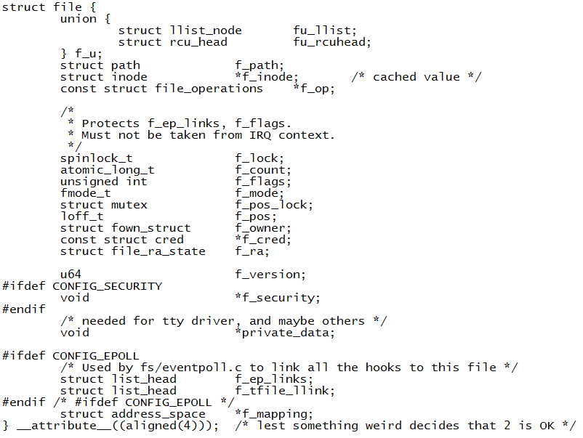
The File Object - struct file
Entry in fd array
fd is the integer used in open(), read(), write(), close() (user level) calls

Slide 15
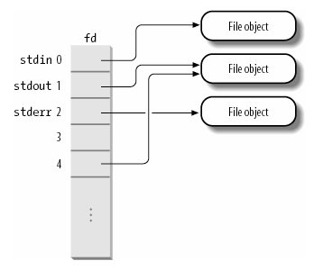
The fd array

Slide 16
Filesystems
In a traditional Unix system, there is only one tree of mounted filesystems: starting from the system’s root filesystem, each process can potentially access every file in a mounted filesystem by specifying the proper pathname.
In Linux 2.6 every process might have its own tree of mounted filesystems — the namespace of the process.
Though most of the time, all processes share the same mounted filesystem

Slide 17
Common types of filesystems

Slide 18
Mounting a filesystem
Before a filesystem can be used, it must be mounted
Mounted gives it a pathname
In Linux, you can mount the same filesystem multiple times
But only one superblock object for these multiple mount points
Mounting forms a hierarchy
You can mount another filesystem under the directory of one

Slide 19
The File System Formats
(for disks)

Slide 20
Purpose
Controls how data is stored, organized, managed and retrieved on a storage media
Provides a logical namespace
Provides an abstract user interface
Provides security

Slide 21
Journaling File Systems
Keeps track of changes not yet committed to the file system's main part
Certain file operations requires multiple writes to different parts of a disk
Example: to delete a file, one has to (1) remove directory entry, (2) release the inode, and (3) move blocks into the free pool
What if system crash in between?
Records the intentions of such changes in a journal
If system crashes, will be able to can recover to a consistent state

Slide 22
File Allocation Table
(FAT)

Slide 23
History
Originally developed by Microsoft, NCR, SCP, IBM, Compaq, Digital Research, Novell, and Caldera
Used in MS-DOS, still used in many embedded media
FAT (8 bit) → FAT12 → FAT16 → FAT32 → exFAT (64 bits)
A linked list format

Slide 24
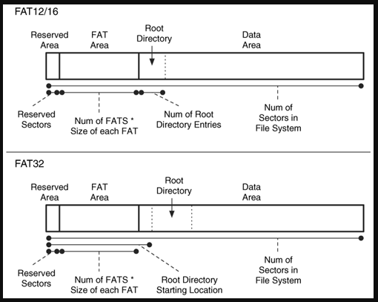
FAT layout

Slide 25
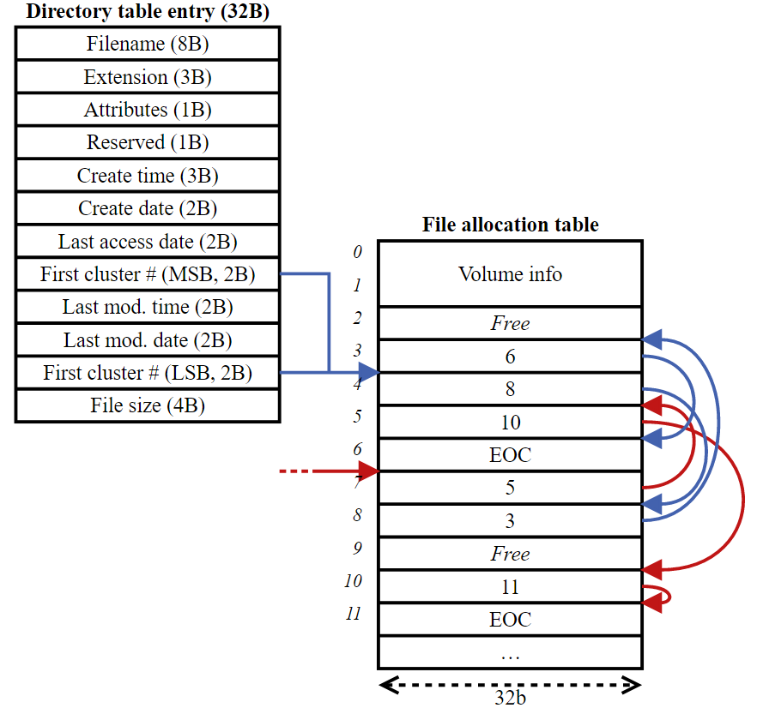
File Allocation Table
A directory table (a.k.a. a folder) is a special file stored in the data area that contains a number of directory table entries. A special root directory table is located in the start of the data area.
A cluster consists of a number of sectors (the storage unit of the device) – it is predefined at formatting time.

Slide 26
Extended Filesystem
(EXT)

Slide 27
EXT2
Introduced in 1993
No journaling
Maximum individual file size can be from 16 GB to 2 TB
Overall file system size can be from 2 TB to 32 TB

Slide 28
EXT3
Introduced in 2001
Starting from Linux Kernel 2.4.15 ext3 was available.
The main benefit of ext3 is that it allows journaling.
Journaling has a dedicated area in the file system, where all the changes are tracked.
Maximum individual file size can be from 16 GB to 2 TB
Overall ext3 file system size can be from 2 TB to 32 TB
There are three types of journaling available in ext3 file system
Journal – Metadata and content are saved in the journal.
Ordered – Only metadata is saved in the journal. Metadata are journaled only after writing the content to disk. This is the default.
Writeback – Only metadata is saved in the journal. Metadata might be journaled either before or after the content is written to the disk.
You can convert a ext2 file system to ext3 file system directly (without backup/restore)

Slide 29
EXT4
Introduced in 2008.
Starting from Linux Kernel 2.6.19 ext4 was available.
Maximum individual file size can be from 16 GB to 16 TB
Overall maximum ext4 file system size is 1 EB (exabyte). 1 EB = 1024 PB (petabyte). 1 PB = 1024 TB (terabyte).
Directory can contain a maximum of 64,000 subdirectories (as opposed to 32,000 in ext3)
You can also mount an existing ext3 fs as ext4 fs (without upgrade).
Several other new features are introduced in ext4 to improved the performance and reliability of the filesystem when compared to ext3.
In ext4, you also have the option of turning the journaling feature “off”.

Slide 30
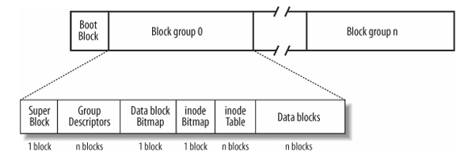
Layout of ext2 Filesystem
Block size is selectable at creation. From 1024 to 4096 bytes.

Slide 31
Ext2
First block reserved for boot sector
A block, just like a cluster in FAT, consists of several contiguous sectors.
The rest partitioned into block groups – all of identical size
Up to 8✕ block-size blocks
Each block group contains one of the following:
A copy of the filesystem’s superblock
A copy of the group of block group descriptors
A data block bitmap
An inode bitmap
A table of inodes
A chunk of data that belongs to a file; i.e., data blocks
Unused, i.e., free

Slide 32
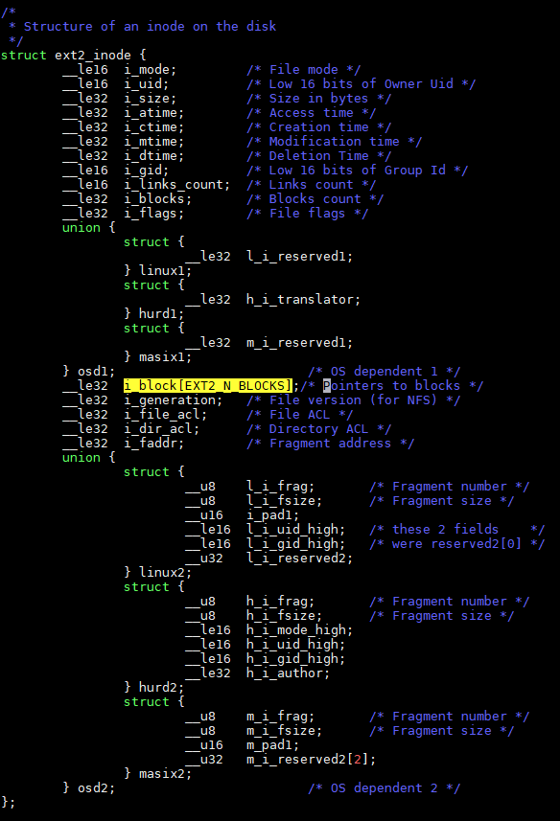
The ext2 inode structure
fs/ext2/ext2.h

Slide 33
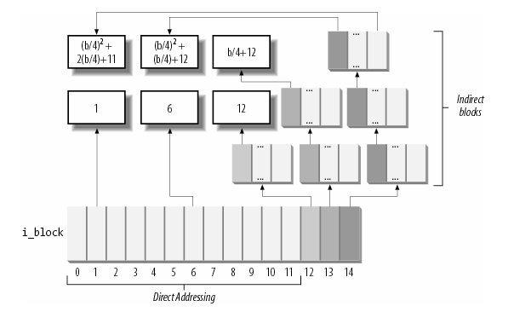
The ext2 file
There are pointers to the first 12 blocks which contain the file's data in the inode.
There is a pointer to an indirect block (which contains pointers to the next set of blocks), a pointer to a doubly indirect block and a pointer to a trebly indirect block.

Slide 34
Limitations
The size of largest file in ext2 format is actually limited by the 32-bit i_blocks field in the inode that represents the number 512-byte sector
Confusingly also called “blocks”
In actual fact, a data block in ext2 can be 1KB, 2KB, 4KB or 8KB

Slide 35
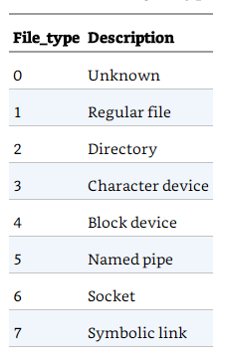
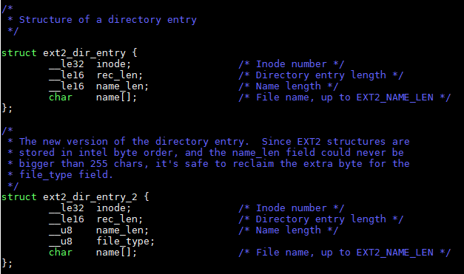
Directory file
Directories are maintained using special file
A file of a special type ‘2’
Data is a simple array of these:

Slide 36
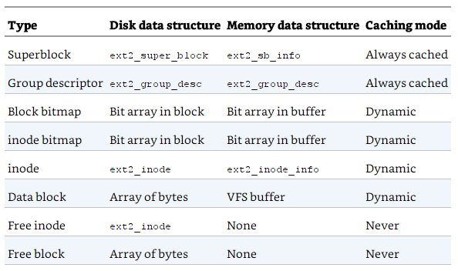
VFS and ext2

Slide 37
Data block allocation
Attempts to allocate each new directory in the group containing its parent directory
Accesses to parent and children directories are likely to be closely related.
Also attempts to place files in the same group as their directory entries
Directory accesses often lead to file accesses
If the group is full, then the new file or new directory is placed in some other non-full group.
The data blocks needed to store directories and files can be found by looking in the data allocation bitmap.
Any needed space in the inode table can be found by looking in the inode allocation bitmap.

Slide 38
Journaling and ext3
As disks and memory became bigger, more and more things buffered; also multiple operations can be split over time
Journaling in ext3 in 2 phases:
First, a copy of the blocks to be written is stored in the journal; then, when the I/ O data transfer to the journal is completed (in short, data is committed to the journal), the blocks are written in the filesystem.
When the I/ O data transfer to the filesystem terminates (data is committed to the filesystem), the copies of the blocks in the journal are discarded.

Slide 39
Journaling Block Device Layer
A hidden file .journal located at the root of the filesystem is used
Journaling is handled by the journaling block device (JDB) layer
Code in fs/jbd2 of kernel source

Slide 40
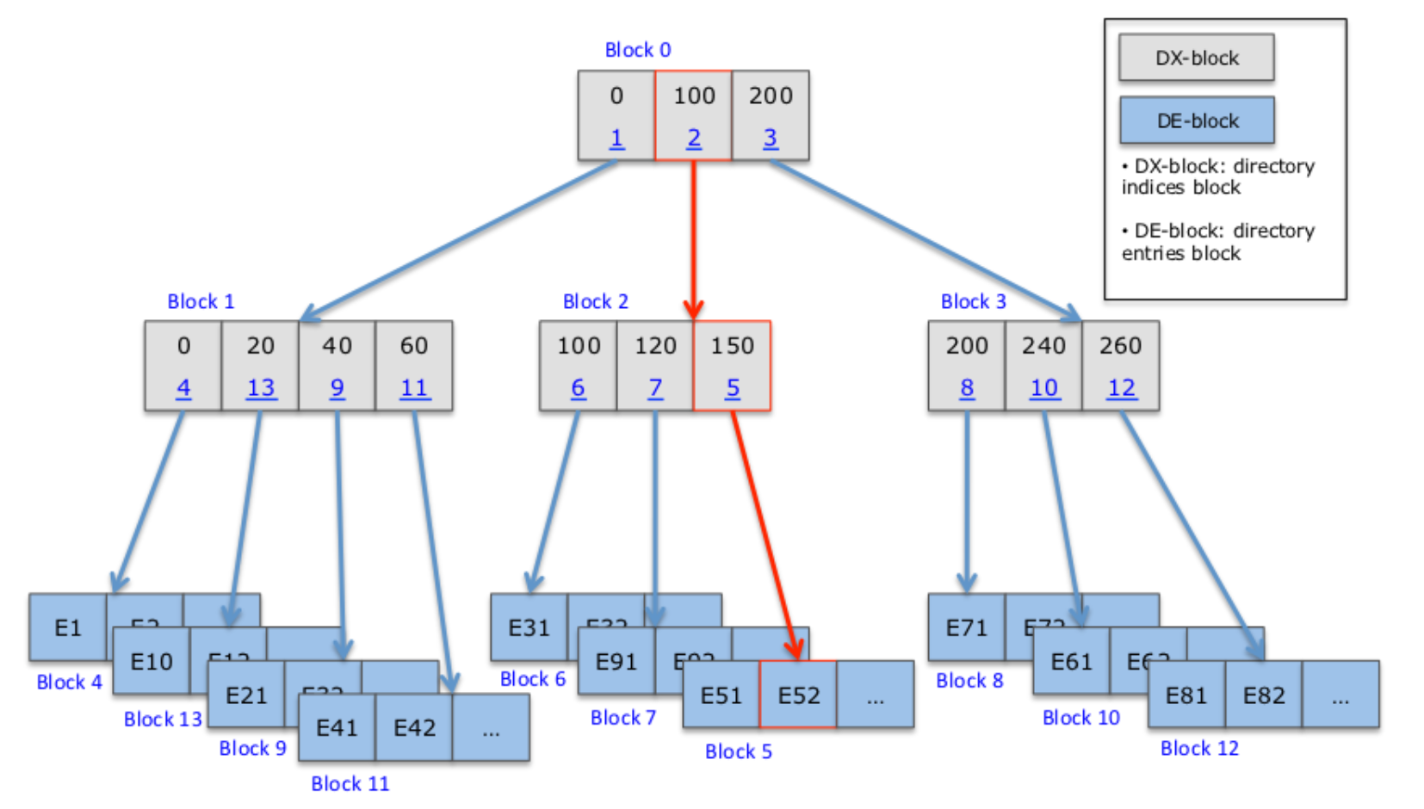
Ext3 Hashed B-tree Directory
A directory is a special file with directory entries
In ext2, directory entries follow a linked list structure
Slow to operate on large directories
Ext3 introduces (optional) HTree (hashed B-tree) for directory layout
Two types of blocks in a HTree directory
Directory Index block (DX-block): stores (hash-value, block-ID) pairs
Directory Entry block (DE-block): stores actual directory entries
B-tree
Source: https://wiki.whamcloud.com/display/PUB/Parallel+Directory+High+Level+Design

Slide 41
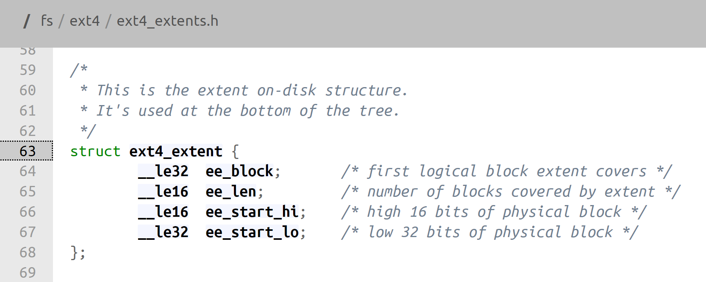
The latest iteration: ext4
Based on ext2/ext3
Insight: very often, the data blocks in a file are contiguous
Can reduce overhead of storing the address to each block
Extent: a range of contiguous disk blocks
Just need to store starting address and the length

Slide 42
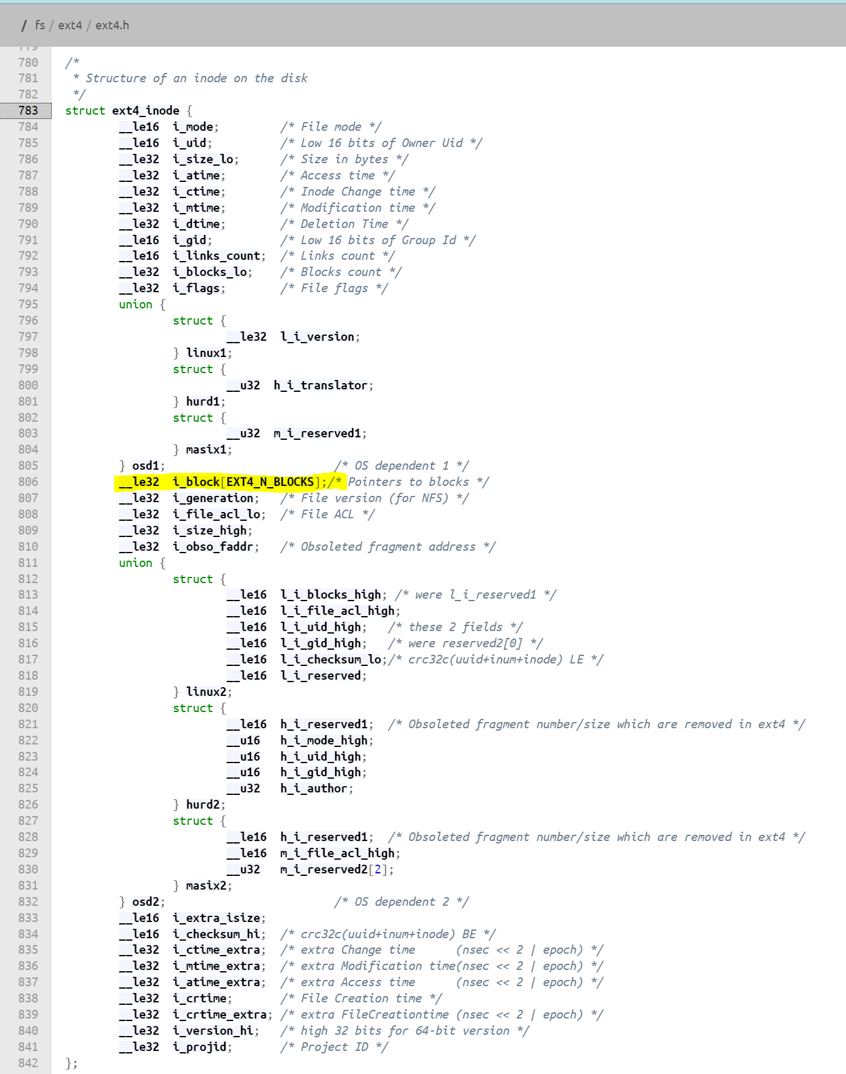
ext4_inode
Almost the same as ext2/3
i_block (60 bytes) can be used to store
the same block structure (direct, indirect, doubly indirect, triply indirect) as ext2/3
Or an extent header and 4 extents (12 bytes each)
Indicated in i_flags
Or the root of an extent B-tree

Slide 43
Extents from inode
Address
i_node
200
.
.
.
i_block
1199
Header
.
.
.
1300
Log. Blk. = 0
Ext. Len. = 1000
2399
Ext. Addr = 200
Log. Blk. = 1001
Ext. Len. = 2000
Ext. Addr = 1300
3000
Log. Blk. = 3001
.
.
.
Ext. Len. = 1000
3999
Ext. Addr = 3000
Log. Blk. = 4001
Ext. Len. = 100
7000
Ext. Addr = 7000
.
.
.
7099
Disk blocks

Slide 44
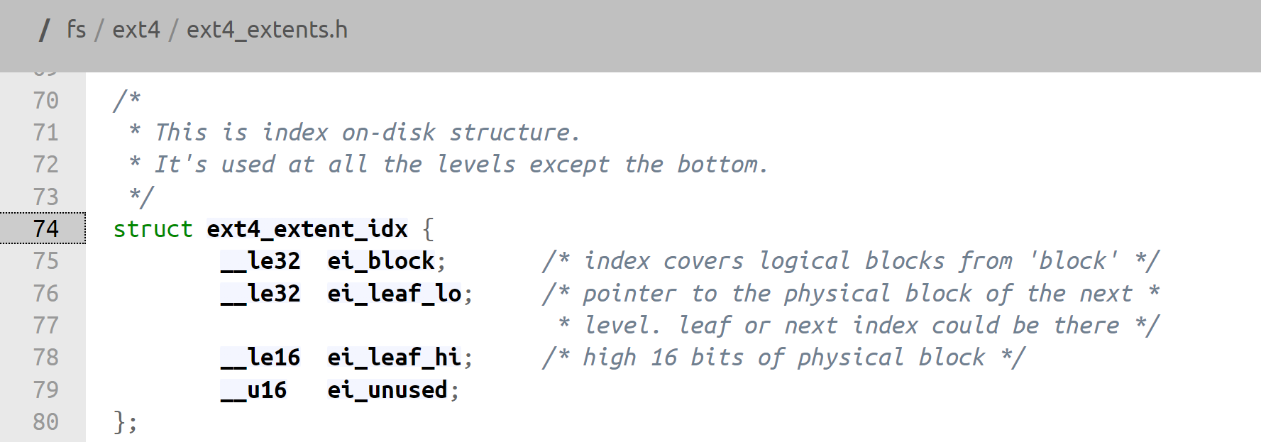
Ext4 Extent Tree
Header
Index node block
i_node
Extent index
Extent index
.
.
.
Extent index
Points to other index or leaf nodes
i_block
Header*
* Inode flag will indicate the use of extents. First extent header will indicate if it is the root of a tree.
Root of extent tree
Header
Leaf node block
Extent info
Similar to the i_block side on Slide 52.
Extent info
.
.
.
Extent info
(Data) extent
(Data) extent
Leaf node extent index can only point to data block
(Data) extent
Disk blocks

Slide 45
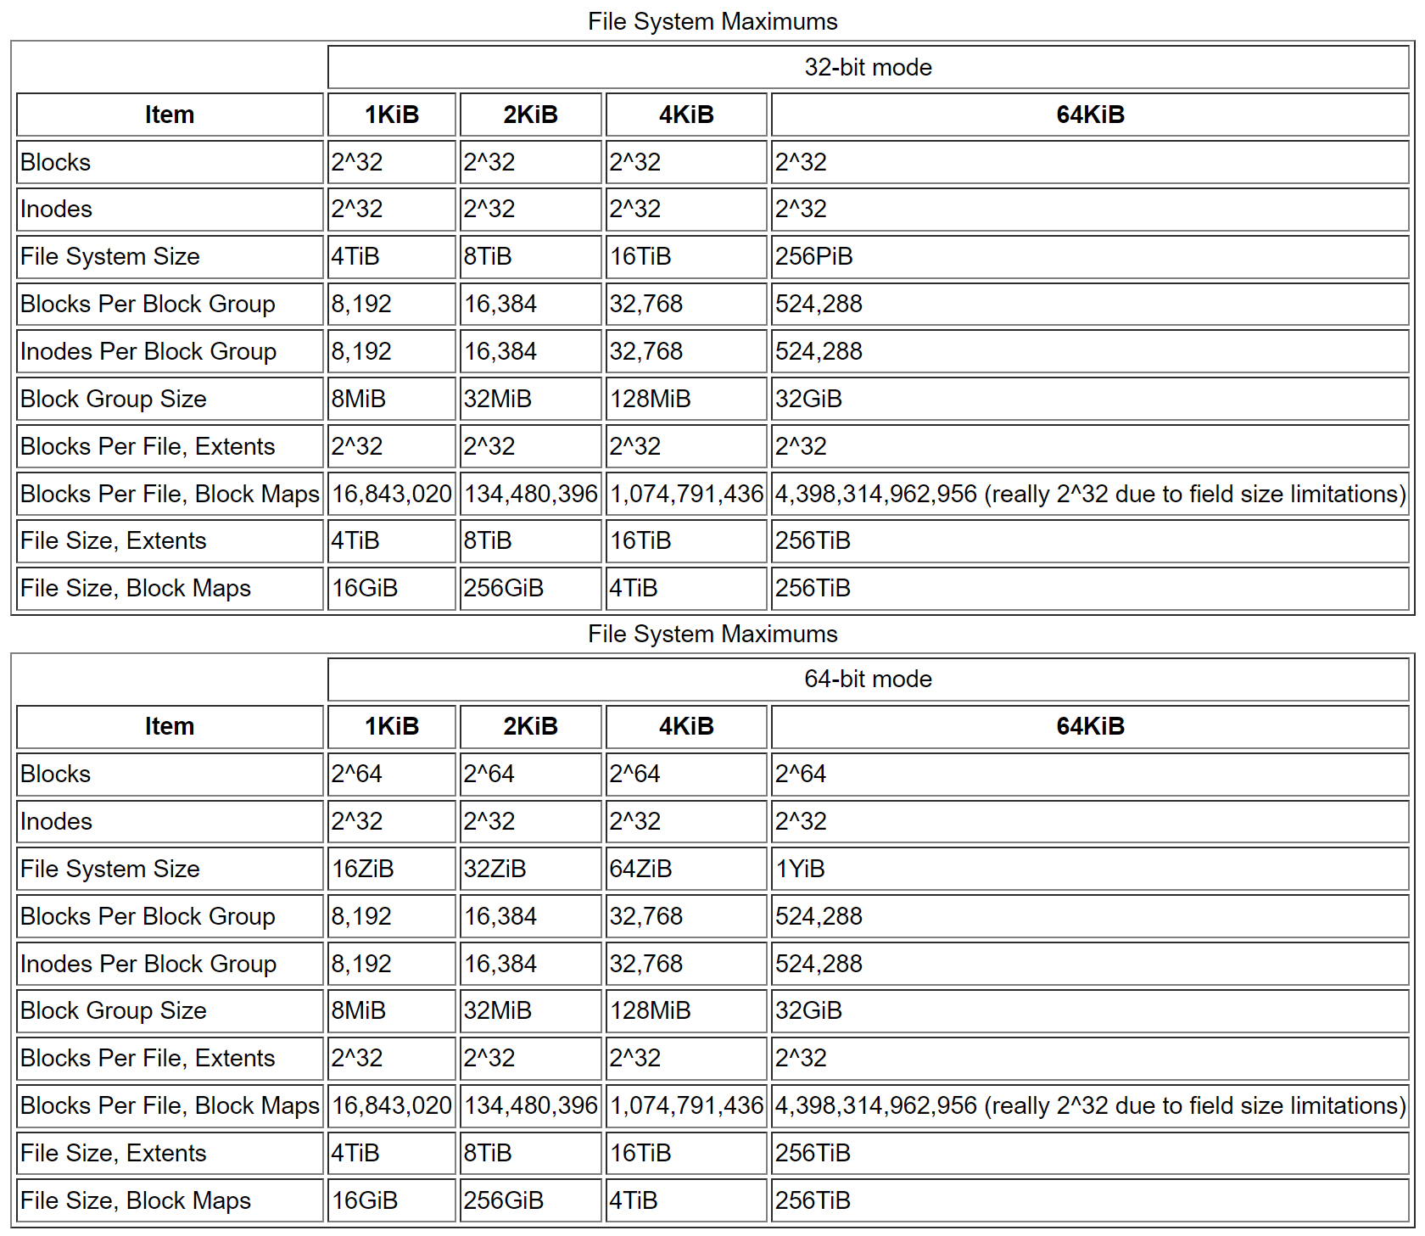
Ext4 is HUGE!

Slide 46
Other improvements of ext4
Persistent pre-allocation
ext4 can pre-allocate on-disk space for a file.
Delayed allocation
Delays block allocation until data is flushed to disk
Unlimited number of subdirectories
Directories can be kept in a B-tree-like format (as an option).
Journal checksumming

Slide 47
Other improvements of ext4
Metadata checksumming
Faster file system checking
By skipping unallocated block groups.
Multiblock allocator
ext3 appends to a file, it calls the block allocator, once for each block.
ext4 uses delayed allocation which allows it to buffer data and allocate groups of blocks.
Nanosecond timestamps
Transparent encryption

Slide 48
The next big one: btrfs
B-tree Filesystem

Slide 49
btrfs vs zfs
Storage device technology changing
Huge capacity
Solid state devices with different storage mechanism
Sun Solaris pioneered ZFS (Zettabyte Filesystem)
Copyright reasons – cannot be distributed officially as part of Linux
Linux support by userspace driver or kernel patch
Btrfs (B-tree Filesystem) – pronounced “better” or “butter” FS
stable version since 2014 by Oracle
GPL
Native Linux kernel support

Slide 50
Main features of btrfs
B-tree based
Uses a b-tree derivative optimized for copy-on-write and concurrency created by IBM researcher Ohad Rodeh for every layer of the file system
Copy-on-write
During a write operation, the old part of data is copied and not discarded
Ref: https://www.researchgate.net/publication/262177144_BTRFS_The_linux_B-tree_filesystem

Slide 51
Definitions
Page, block: a 4KB contiguous region on disk and in memory.
Extent: A contiguous on-disk area. It is page aligned, and its length is a multiple of pages.
Copy-on-write (COW): creating a new version of an extent or a page at a different location. Also called shadowing.
Checksum: a hash value used to check the integrity of stored data
Snapshot: a copy of the file system taken at a certain point in time; also called a clone

Slide 52
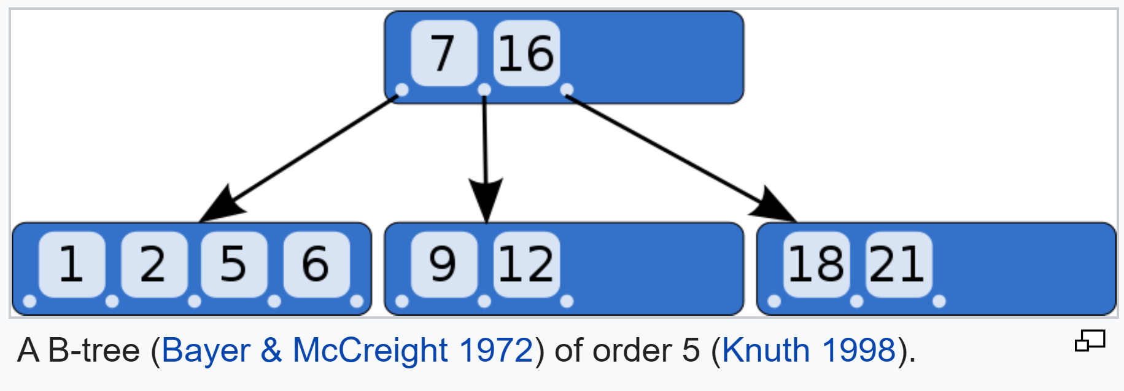
B-trees
B-tree is a type of binary search tree
self-balancing
sorted data
searches, sequential access, insertions, and deletions in logarithmic time.
Source: Wikipedia

Slide 53
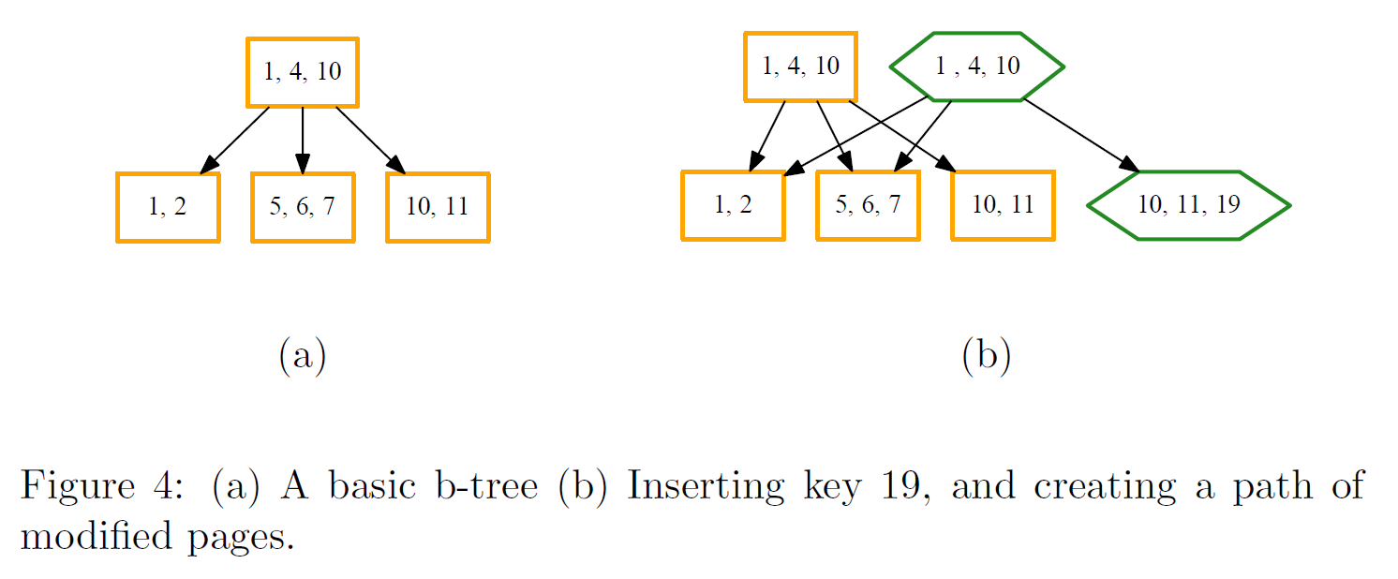
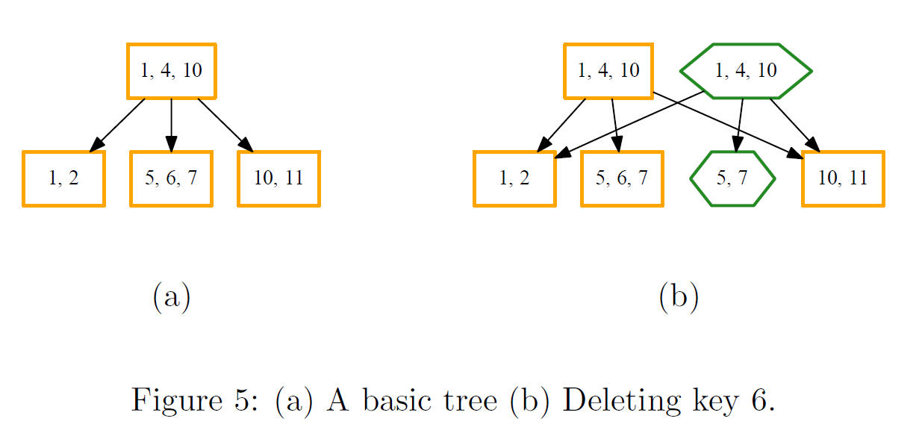
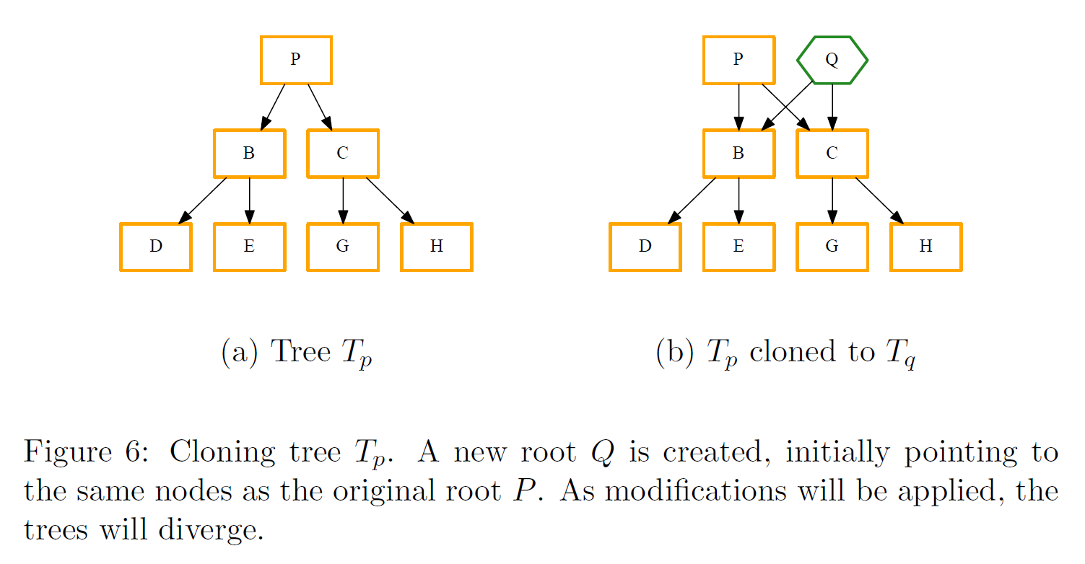
The core idea: COW-friendly B-tree
Source: O. Rodeh, J. Bacik, and C. Mason,
BTRFS: The Linux B-tree filesystem

Slide 54
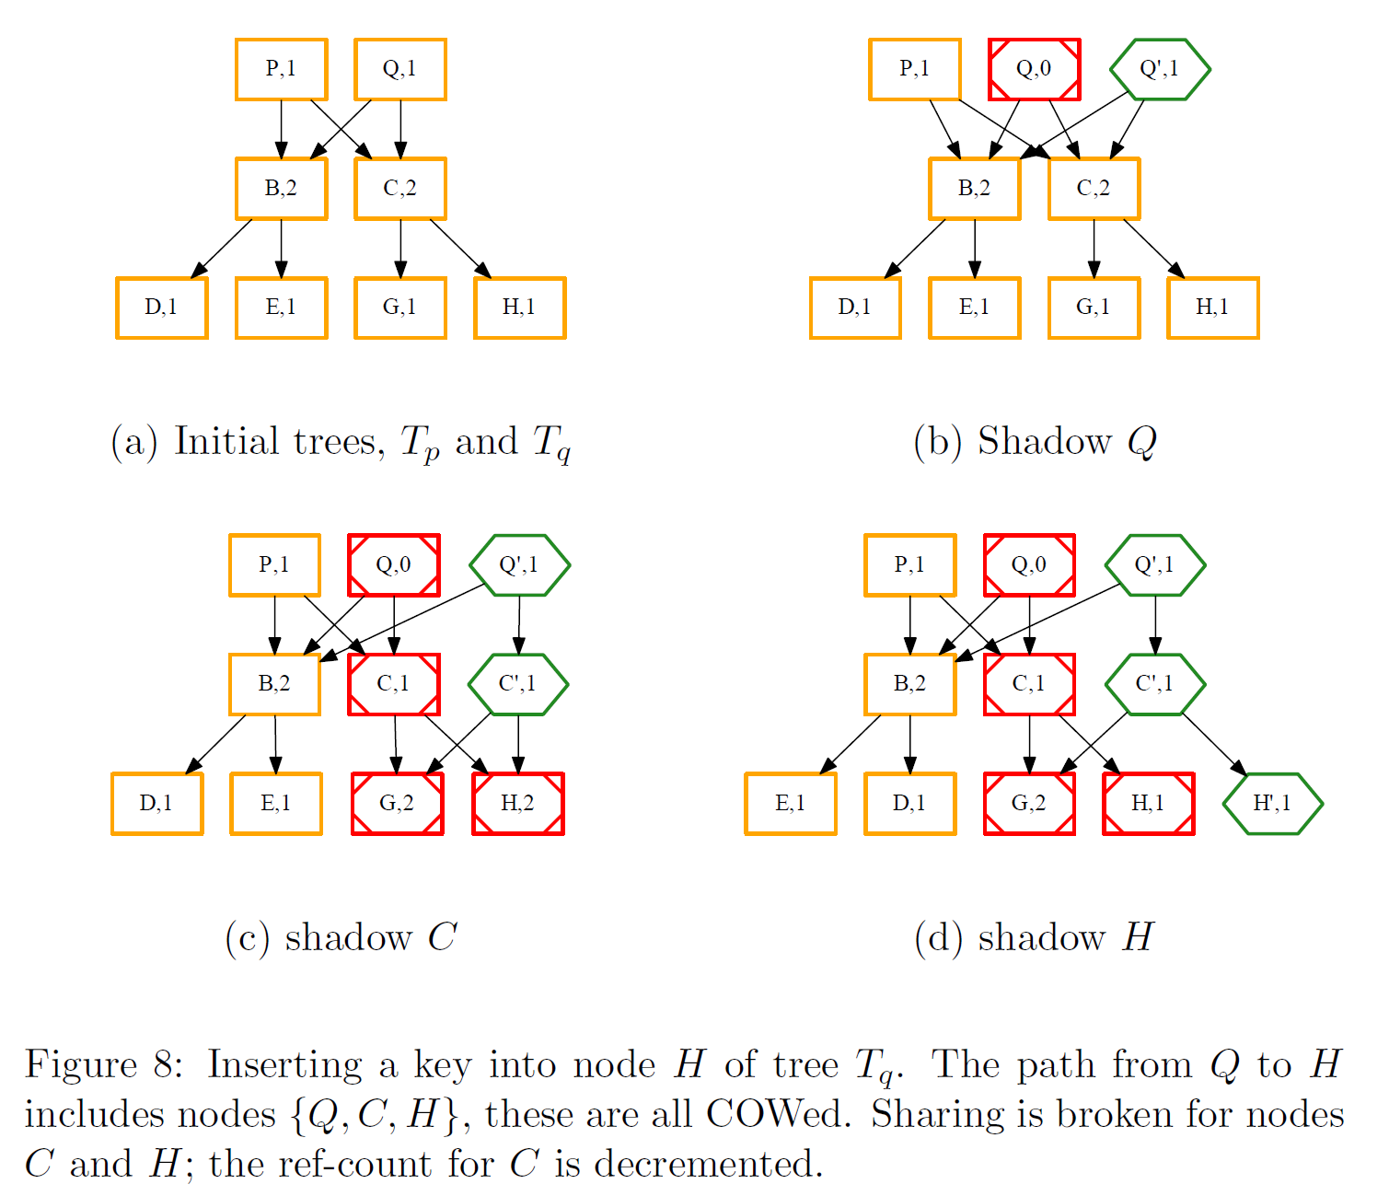
COW-friendly tree: inserting a node
Reference count
(for garbage collection)

Slide 55
COW-friendly tree: inserting a node
Original node, RC decremented

Slide 56
COW-friendly tree: inserting a node
New node

Slide 57
COW-friendly tree: inserting a node

Slide 58
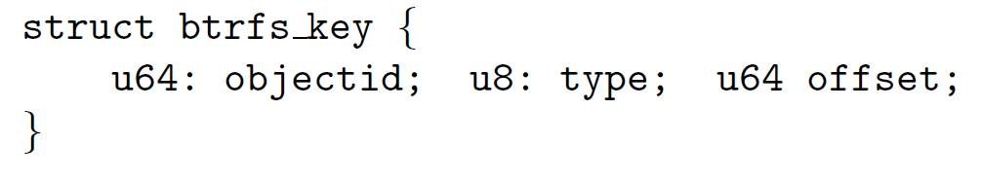
A btrfs B-tree
A btrfs B-tree only has three types of data structures: keys, items, and block headers.
The block header is fixed size and holds fields like checksums, flags, filesystem ids, generation number, etc.
A key describes an object address:

Slide 59
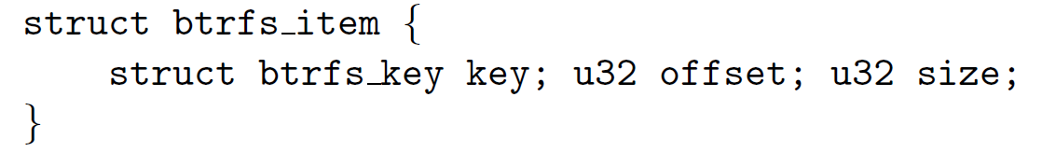
Items
An item is a btrfs key with additional offset and size fields

Slide 60
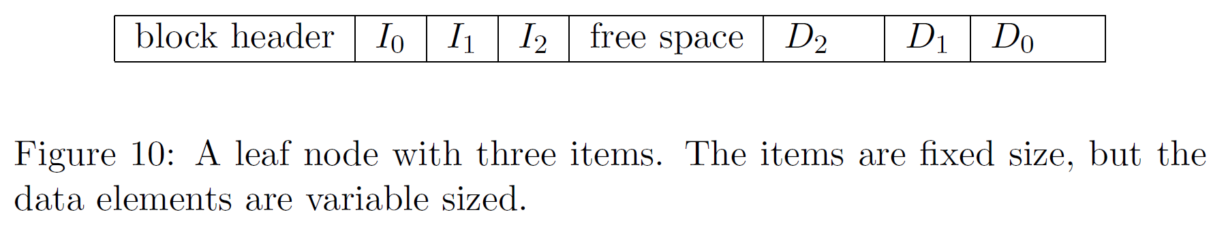
In a btrfs B-tree
Internal tree nodes hold only [key, block-pointer] pairs.
Leaf nodes hold arrays of [item, data] pairs.
Item data is variable sized.
A leaf stores an array of items in the beginning, and a reverse sorted data array at the end. These arrays grow towards each other.

Slide 61
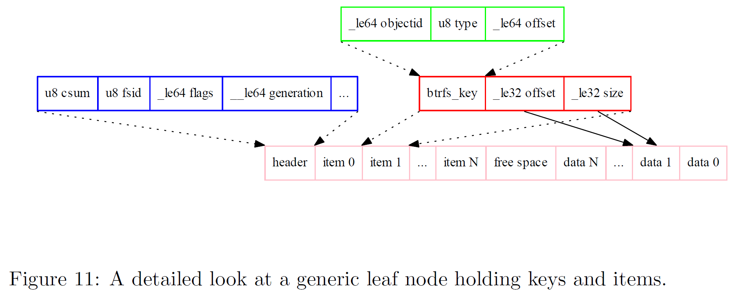

Slide 62
Inodes on btrfs
Inodes are stored in an inode item at offset zero in the key, and have a type value of one.
Inode items are always the lowest valued key for a given object, and they store the traditional stat data for files and directories. This includes properties such as size, permissions, flags, and a count of the number of links to the object.
The inode structure is relatively small, and will not contain embedded file data, extended attribute data, or extent mappings.
These things are stored in other item types.

Slide 63
Small files in btrfs
Small files that occupy less than one leaf block may be packed into the b-tree inside the extent item.
The key offset is the byte offset of the data in the file
The size field of the item indicates how much data is stored.
There may be more than one of these per file.

Slide 64
Large files on btrfs
Larger files are stored in extents. These are contiguous on-disk areas that hold user-data without additional headers or formatting.
An extent item has
a generation number recording when the extent was created,
a [disk block, length] pair to record the area on disk, and
a [logical file offset, length] pair to record the file area.
An extent is a mapping from a logical area in a file, to a physical area on disk
If a file is stored in a small number of large extents, then a common operation such as a full file read will be efficiently mapped to a few disk operations.

Slide 65
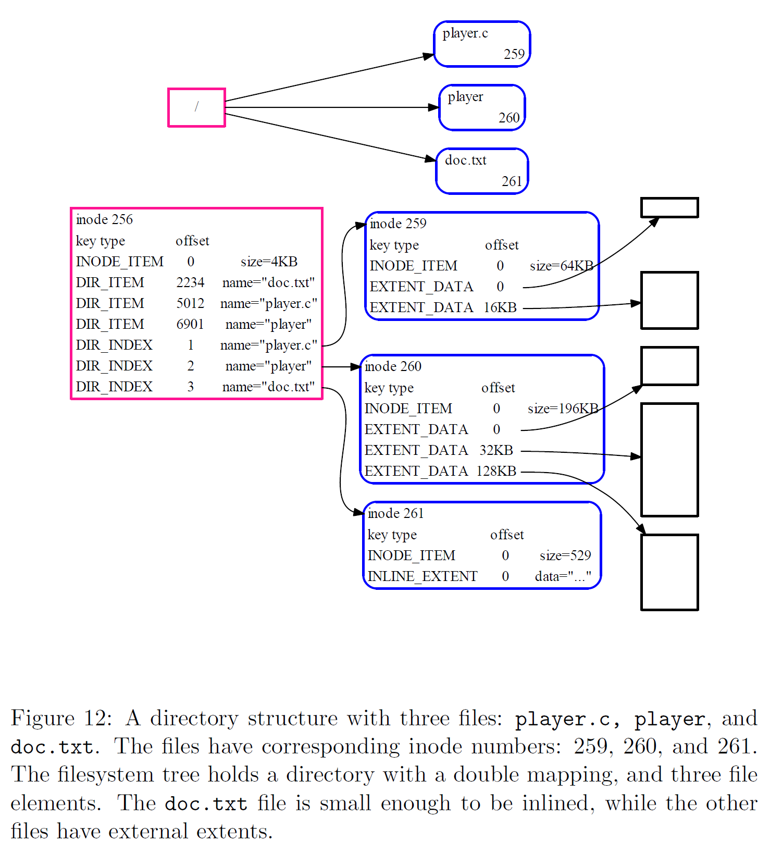
Directories in btrfs

Slide 66
btrfs Filesystem
A filesystem is constructed from a forest of B-trees.
A superblock located at a fixed disk location is the anchor. It points to a tree of tree roots, which indexes the b-trees making up the filesystem. The trees are:
Sub-volumes: store user visible files and directories.
Extent allocation tree: tracks allocated extents in extent items, and serves as an on-disk free-space map.
Checksum tree: holds a checksum item per allocated extent.
Chunk and device trees: indirection layer for handling physical devices. Allows mirroring/striping and RAID.
Reloc tree: for special operations involving moving extents.

Slide 67
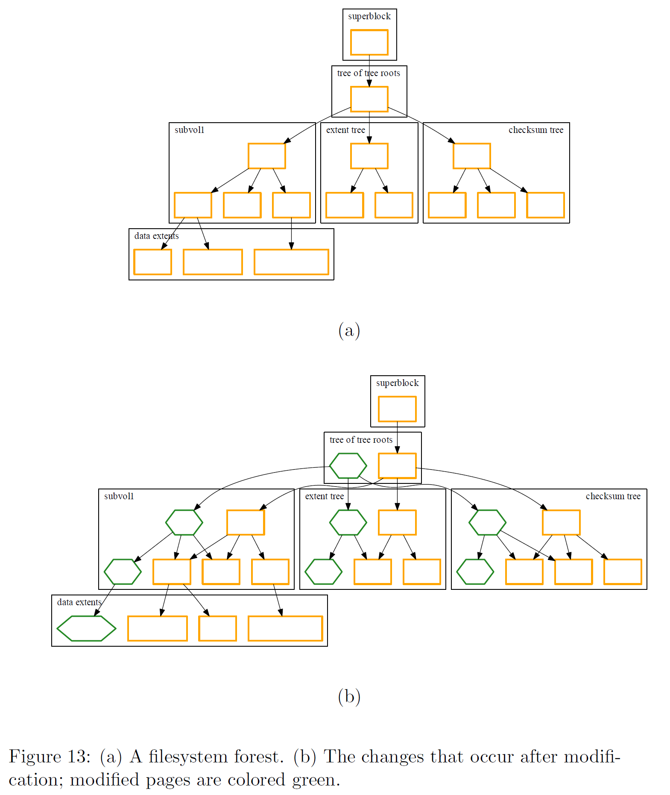

Slide 68
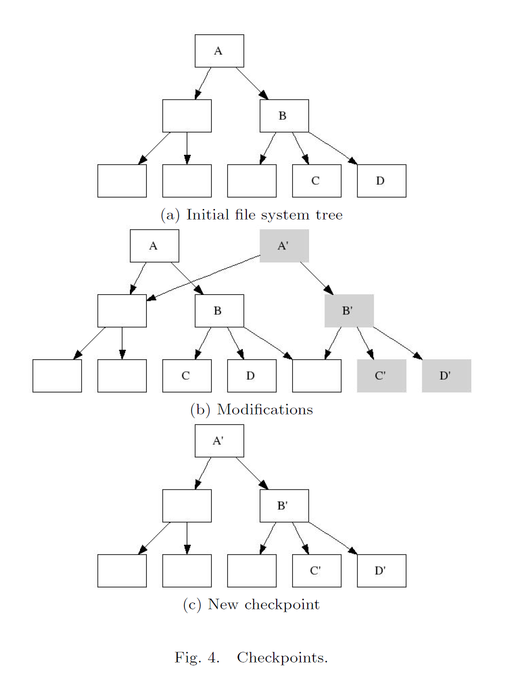
Checkpointing

Slide 69
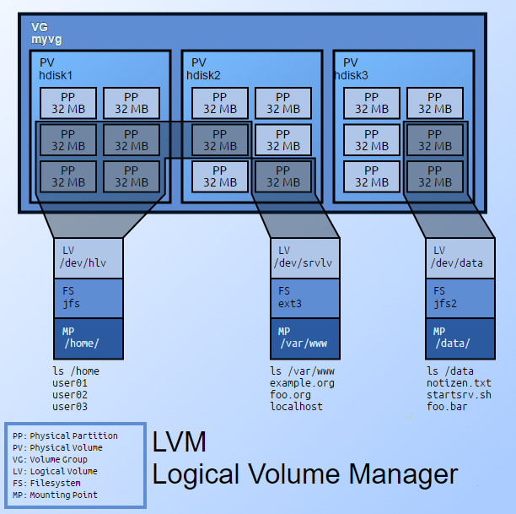
Final digression: Logical Volumes
A thin software layer on top of the hard disks and partitions, which creates an abstraction of continuity and ease-of-use for managing hard drive replacement, repartitioning and backup.

Slide 70
New Technology File System
(NTFS)
Source: David Riley, UW @ La Crosse

Slide 71
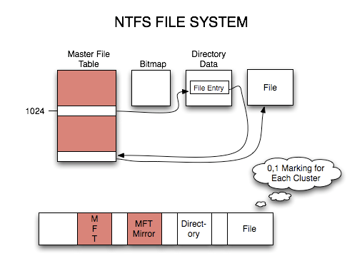
Basic Implementation
Fundamental Data Structure of NTFS is the Metafile.
The Metafiles:

Slide 72
Availability and Integrity
$LOGFILE
At the same time files are modified, certain information about the changes are written in two different record types to $LOGFILE.
Redo records are written with information about the modification that must be redone if a modify or delete process is interrupted.
An undo record is written in order to facilitate the rollback of an append if the process fails between the time the file is extended and the data is actually written in the new free space created.
Journaling

Slide 73
Availability and Integrity
$MTFMIRR
Metafile that is stored “in the middle” of the disk as a backup-copy of $MFT.
Used in case MFT is corrupted.
$BOOT (which can be stored at either the first or last sector of the disk) holds pointers to both the $MFT and $MTFMIRR

Slide 74
Availability and Integrity
$BADCLUS
If an error occurs while reading data off of an NTFS formatted partition NT will assume that the cluster is a “bad cluster.”
The error recovery process will then enter the cluster into the $BADCLUS metafile
It will then recover what it can of the data and place it in another location.
This feature is enhanced greatly with fault-tolerant file system drivers.

Slide 75
Confidentiality and Security
$MFT
Each file and folder has it’s own record in the $MFT.
Within that record is a pointer to an attribute record $SECURITY_DESCRIPTOR
The Security Descriptor holds information that allows NT to map permissions (Allow or Deny of: Read, Write, Execute, Modify, Full, etc) to Users (represented by their internal SID)
S-1-5-21-XXXXXXXXX-XXXXXXXXX-XXXXXXXXX-500 represents the local machine’s “Administrator” account.
If no SID exists in $SECURITY_DESCRIPTOR the permission is assumed to be an outright “deny” of all rights.
As demonstrated earlier, $SECURITY_DESCRIPTOR is read by the NT operating system, not by the hardware. Therefore, it can be bypassed and the data accessed directly on disk.

Slide 76
Confidentiality and Security
Encrypting File System (EFS)
New in NTFS 5.0 (Windows 2000)
Uses Windows 2000 Cryptography Services.
Users can explicitly specify to encrypt a file, or Windows 2000 will automatically encrypt files that are within a folder that has been specified as encrypted.
Uses a stronger variant of DES called DESX. This process is symmetric and quicker than asymmetric technologies which is ideal when encrypting what can be huge (up to 2TB) files.

Slide 77
End

